Slide 1
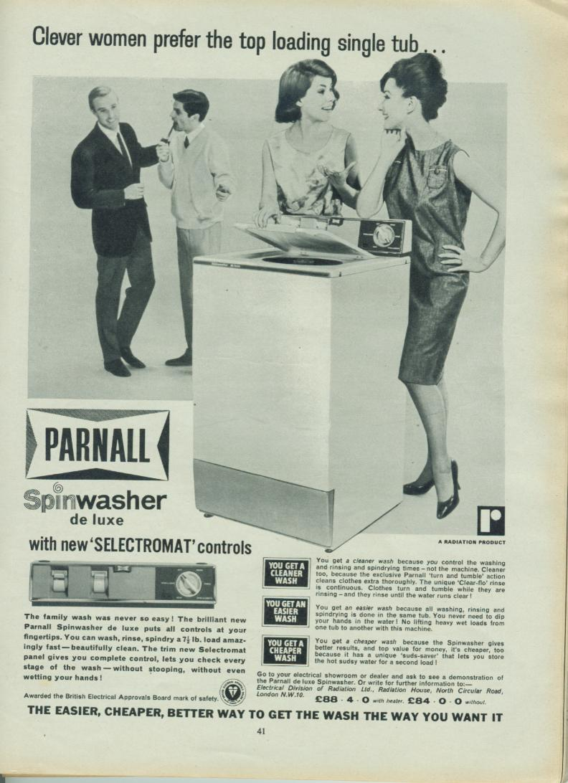
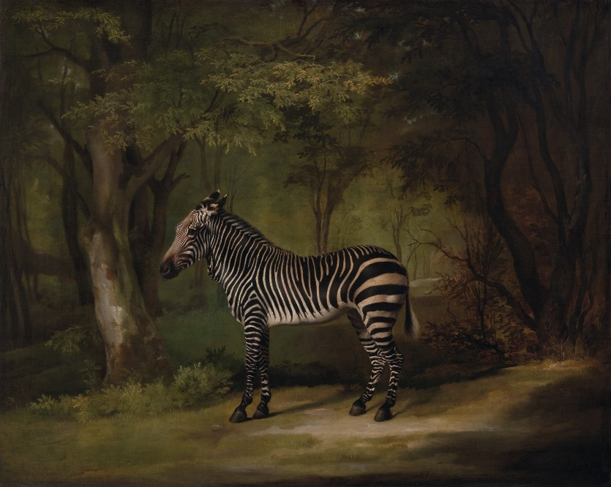
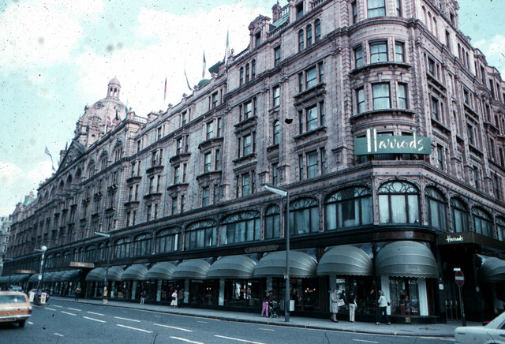
Zebras, department stores, and washing machines: connecting the dots of provenance in the age of digital technology
Notes:
The objects that our institutions care for have complex lives and thinking about the events that make up these lives is going to be the silver lining throughout my talk today.

Slide 2
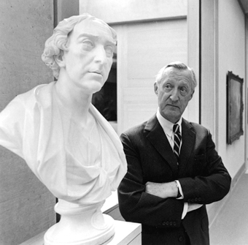
Linked Open Data supported provenance scholarship at the Yale Center for British Art
Paul Mellon (1907-1999) and Thomas Dawson, first Baron Dartrey (Later first Viscount Cremorne). Bust by Joseph Wilton RA, 1722–1803, British, ca. 1770, Carrara marble on an original oval socle, Yale Center for British Art, Paul Mellon Collection, B1977.14.33
Notes:
I will also be discussing how we can use LOD to help us document and research the fascinating histories of these works of art. So just to be clear we are talking about the events in the lives of the objects. Not so much their basic physical descriptions anymore. I will be talking about how our works exist across time and space and interact with people and organizations.
I was thrilled when CMOA asked us to participate in this NEH grant not only because the Center had been planning to leverage LOD to make our provenance information work harder for us, but also because the CMOA team, and David in particular, had already demonstrated such an amazing forward thinking way to deal with provenance in the digital age.

Slide 3
Goal & Scope
Transform provenance free text documentation into structured linked open data to support research
1,525 paintings from the Paul Mellon collection
History of ownership (not movements of objects)
Future: extend data model and methodology to other collections at the YCBA and other Paul Mellon Collections at other institutions (VMFA, NGA)
Notes:
The general goal of this initiative for the YCBA is to transform our provenance free text documentation into structured LOD to support research and be able to answer complex questions about Paul Mellon’s collecting habits.
The scope is to focus on the 1,525 paintings that were formerly owned by Mr. Mellon (out of 2,065 accessioned paintings today). The Center has an active collection development program of course, and we are hoping that we will be able to extend the model and methodology developed in this project to deal with provenance of other collections at the Center and other Paul Mellon collections at other museums (VMFA, NGA).
And just to be clear again, we are currently only working on the history of ownership, not on the movements of objects, such as when objects have been on loan since coming to the Center, or before coming to the Center, such as when 80 paintings were sent from Paul Mellon’s Virginia residence to the Mellon bank in Pittsburgh in the 1960s.

Slide 4
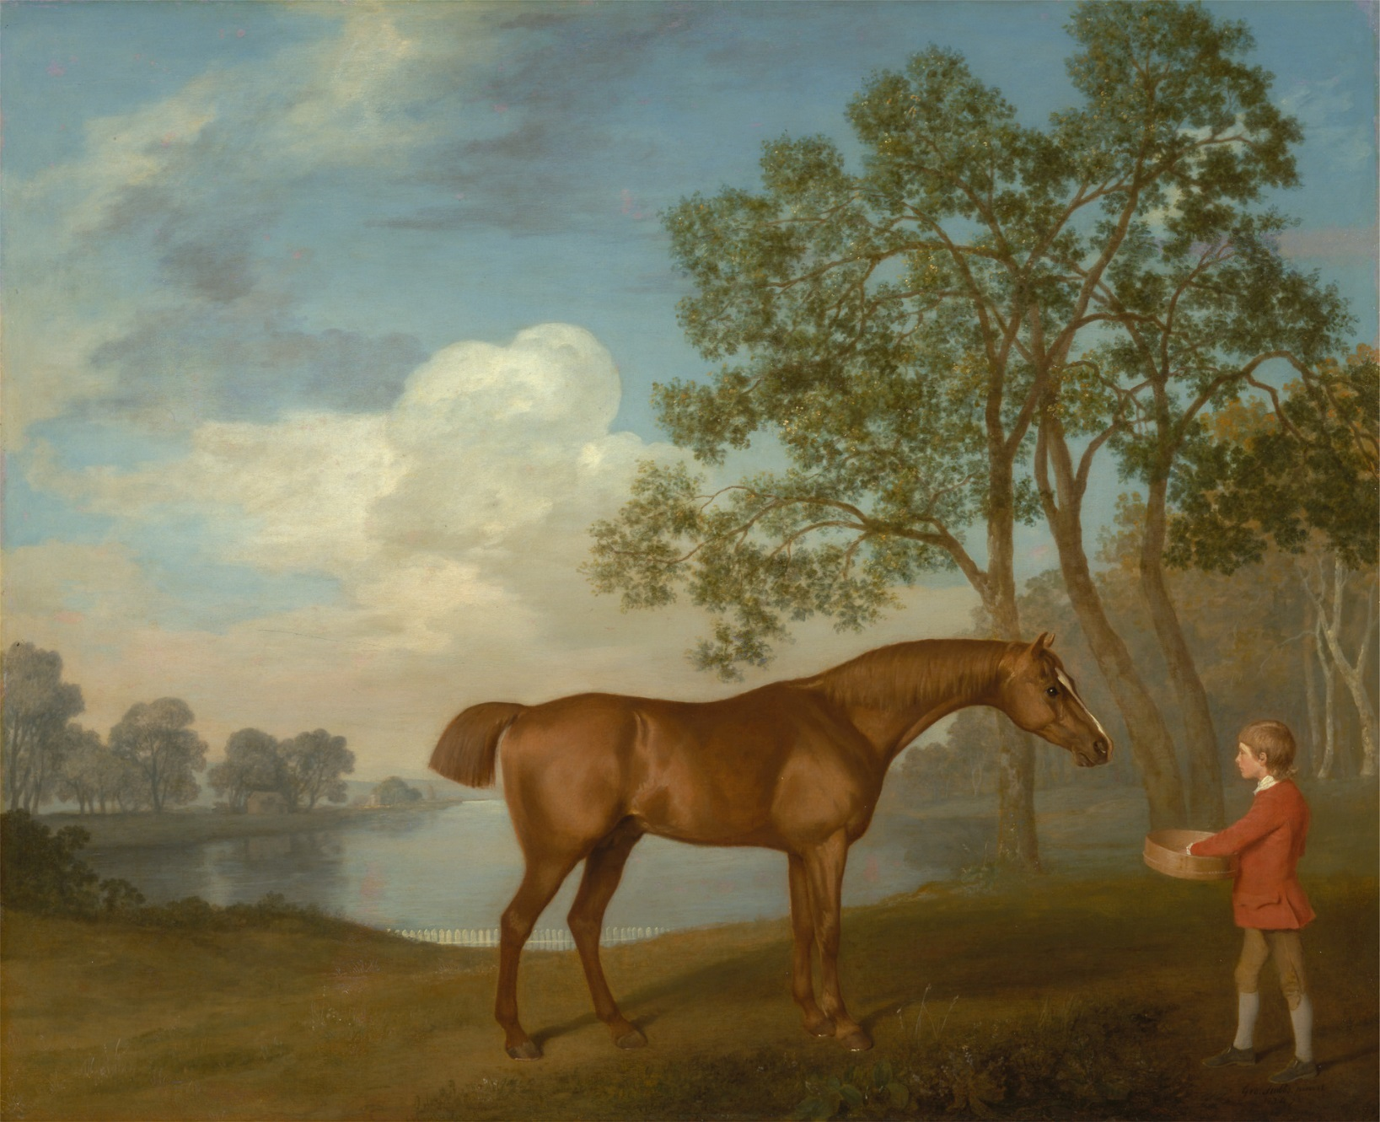
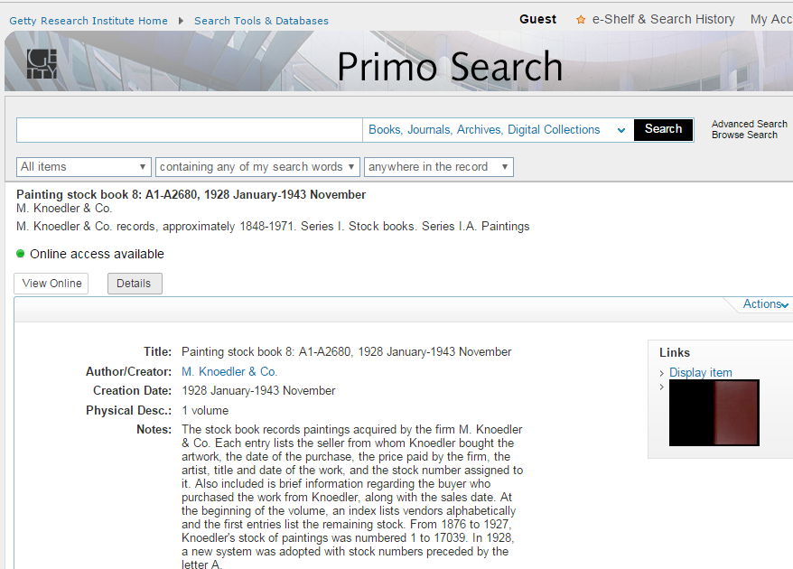
Paul Mellon Collection
1936: acquisition of George Stubbs’ Pumpkin with a Stable-lad
Knoedler stock book: http://hdl.handle.net/10020/2012m54b8
George Stubbs, 1724–1806, British, Pumpkin with a Stable-lad, 1774, oil on panel, Yale Center for British Art, Paul Mellon Collection B2001.2.69, http://collections.britishart.yale.edu/vufind/Record/1667168
Notes:
So let me give you a little bit of background information about Paul Mellon and how his collection at the YCBA came to be and in the process I am going to ask some questions that we hope to be better able to answer through Linked Open Data. Paul Mellon (1907-1999) was one of the greatest American collectors and philanthropists of the second half of the 20th century, born here in Pittsburgh of course, and he certainly was the greatest collector of British art from any period. He assembled his remarkable collection rather quickly, starting earnestly only in the 1960s, and by 1980 he was already one of the most well-known American collector ever. So by nature, he offers us a great case when it comes to studying collecting habits.
So here are a few key dates related to the PM collection at the YCBA:
1936: when he was 29 years old, Paul Mellon bought his first British painting which was by George Stubbs. He bought it from Knoedler’s in New York and here I am showing the dealer’s stock book at the GRI, which is a fabulous digital resource with persistent links. I wish they were transcribed for searching.

Slide 5
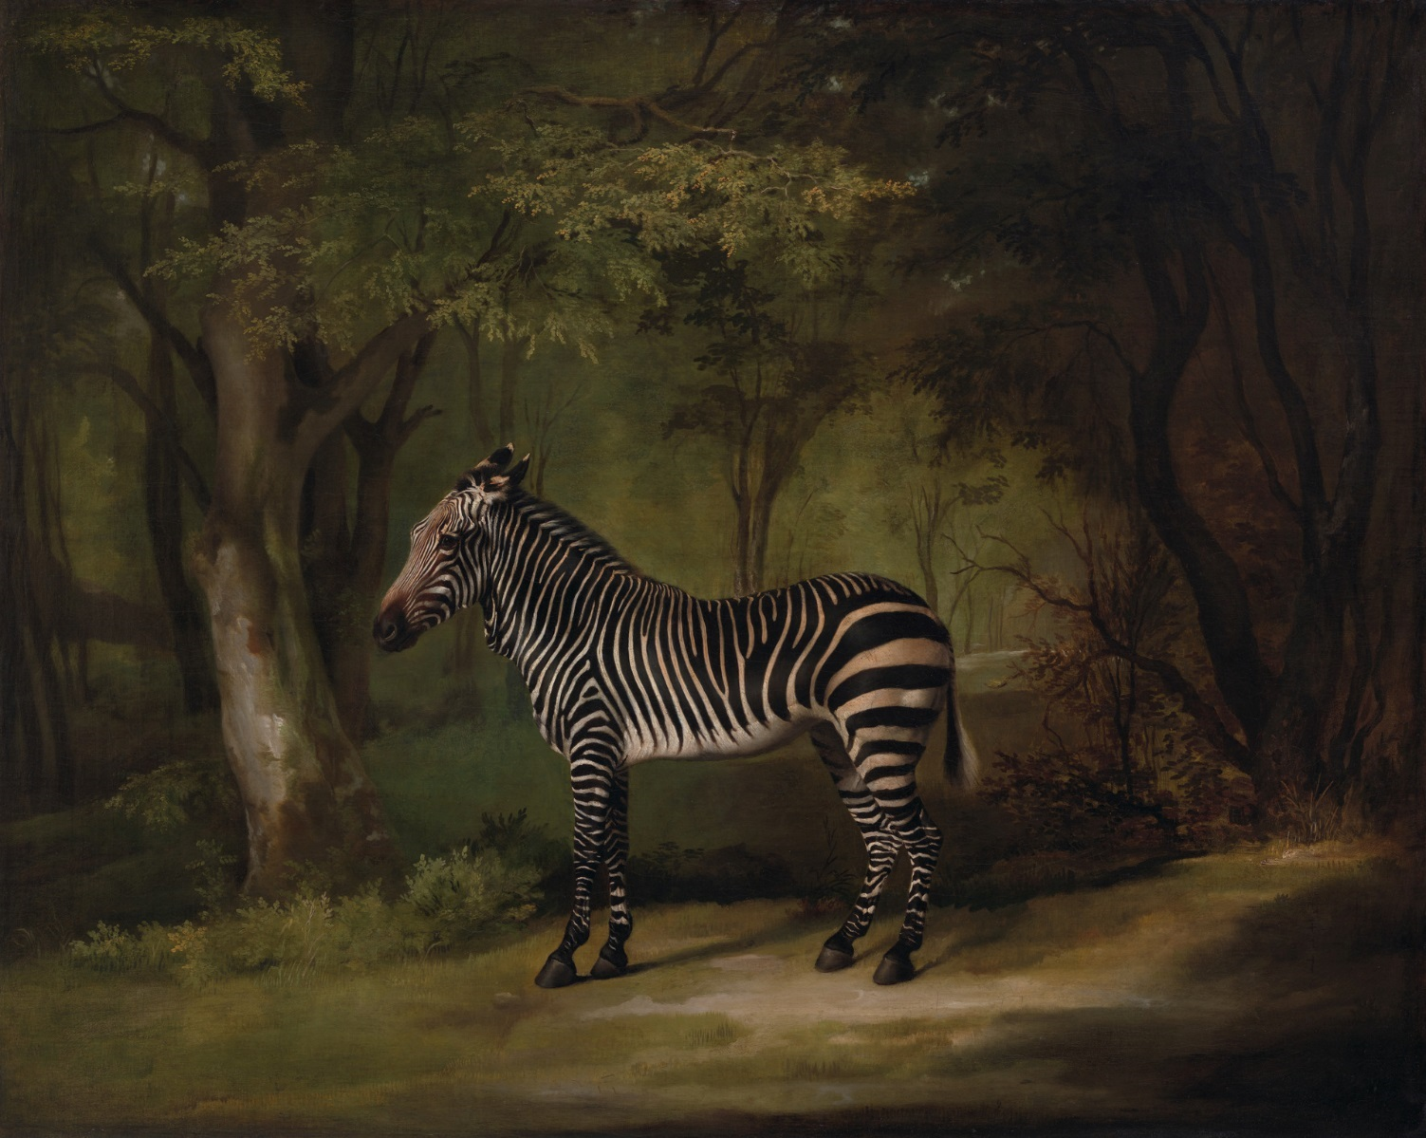
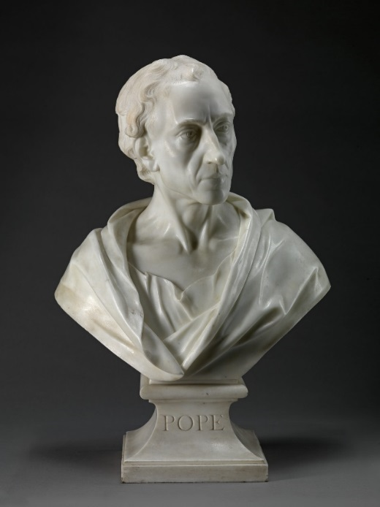
Paul Mellon Collection
1936: acquisition of George Stubbs’ Pumpkin with a Stable-lad
1959: meeting with Basil Taylor (1922-1975), advisor from 1960-68; acquisition of George Stubb’s Zebra
Paul Mellon’s last acquisition in 1990 (on his own account and through John Baskett): Louis François Roubiliac, 1702–1762, French, active in Britain (from 1730), Alexander Pope, 1741, marble, Yale Center for British Art, Gift of Paul Mellon in memory of the British art historian Basil Taylor (1922–1975)
George Stubbs, 1724–1806, British, Zebra, 1763, Oil on canvas, Yale Center for British Art, Paul Mellon Collection, B1981.25.617, http://collections.britishart.yale.edu/vufind/Record/1669240
Notes:
June 1959: Paul Mellon meets Basil Taylor, then Librarian at the Royal College of Art, who became his close advisor. That’s when Paul Mellon began to amass a major collection of British art with the help and encouragement of English art historian Basil Taylor. And later that year he bought Stubbs’ Zebra.
After passing through a number of hands Stubbs’ Zebra painting reappeared almost 200 years later, among a selection of old washing machines and second-hand goods that Harrods, the famous department store used to offer for auction as a sideline. Colnaghi’, the Bond Street art dealer, bought it for 20,000 pounds for Paul Mellon. Who else was buying from Colnaghi in the 1960s?
Paul Mellon’s first 2 acquisitions set up the stage for what was about to ensue: he was a discreet man who used agents and he had a very distinct liking for 18th century British paintings at a time when that type of art was not the most popular. Again, wouldn’t it be nice to be able to support this with a more thorough study of the art market of the time?
Stubbs remained a favorite throughout his life and scholars say that Paul Mellon’s interest in Stubbs’ work did much to rehabilitate the artist’s reputation. Wouldn’t it be nice to correlate this with prices that Stubbs’ works fetched at auctions before and after 1960s?

Slide 6
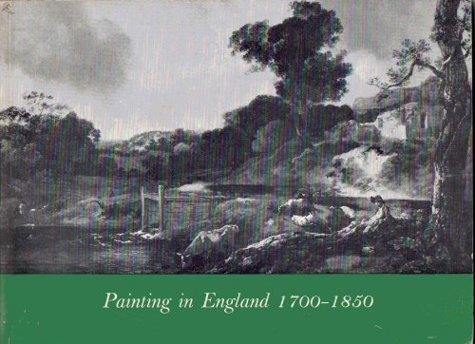
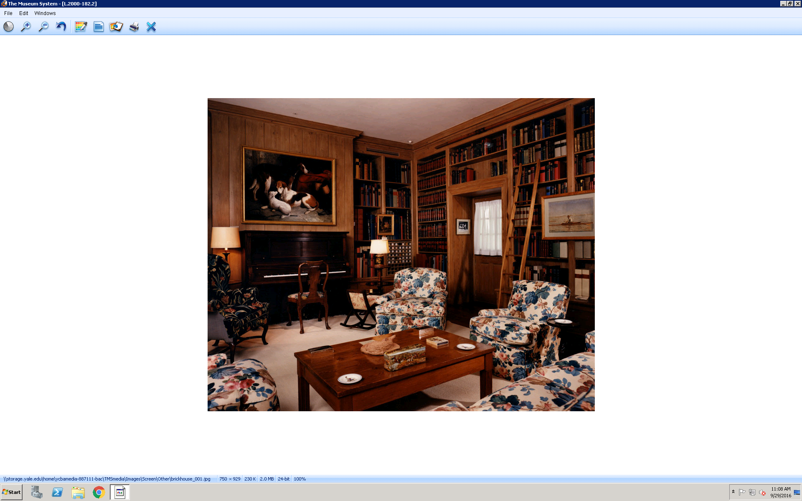
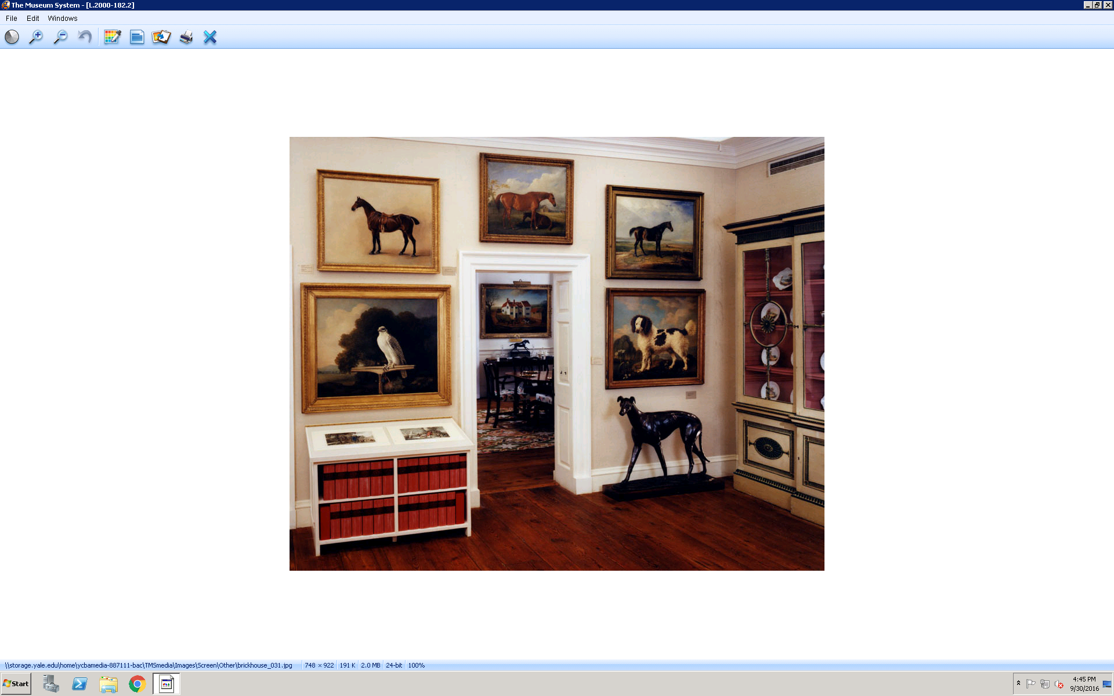
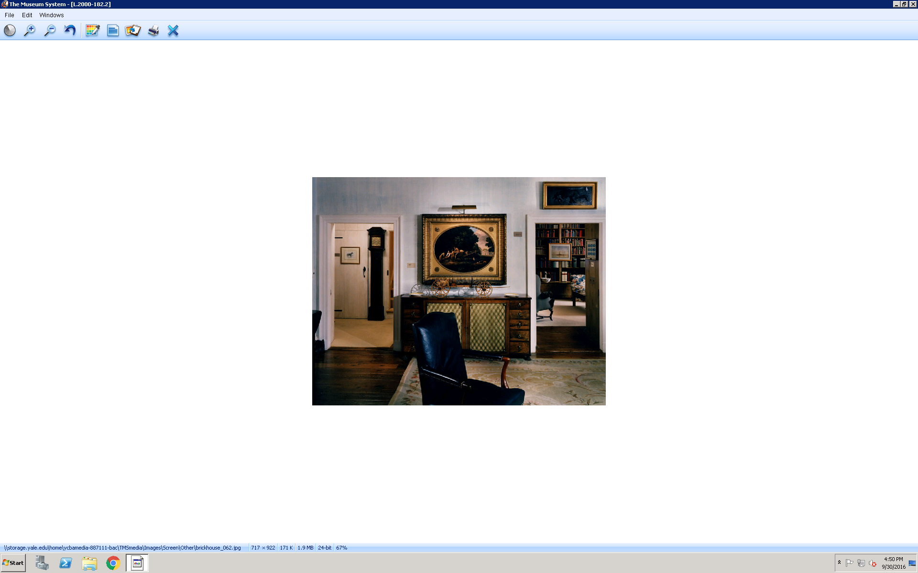
Paul Mellon Collection
1936: acquisition of George Stubbs’ Pumpkin with a Stable-lad
1959: meeting with Basil Taylor, Librarian at the Royal College of Art; acquisition of George Stubb’s Zebra
1963-65: Painting in England, 1700-1850, Collection of Mr. & Mrs. Paul Mellon at the VMFA & RA, London
Notes:
1963: By then John Baskett, whom he met in 1960, moves to Virginia to be Paul Mellon’s private curator at the Brick House and I am showing interior views of it here.
This year Paul Mellon’s growing English picture collection is exhibited at the VMFA in Painting in England, 1700-1850, Collection of Mr. & Mrs. Paul Mellon. Basil Taylor wrote the exhibition catalog. It showed many conversation pieces, intimate landscapes and animal pictures, and per Basil Taylor that exhibition did not present “a total view of English painting as much as the personal taste of a private collector.” Another characteristic of his collecting is that he acquired entire collections formed earlier in England by others such as Duke, Lowinsky, Martin Hardie, Iolo Williams and Girtin collections. It is crucial that this distinctive trait of his come through our Linked Open Data model.
The exhibition later traveled to the Royal Academy, London and is said to have helped revive serious interest in British art among scholars. It would be useful to have data on the British art market before 1960 to be able to put some flesh on this hypothesis. In 1963 PM also starts to think about possible venues for his collection (http://archives.yalealumnimagazine.com/issues/99_07/Mellon.html)

Slide 7
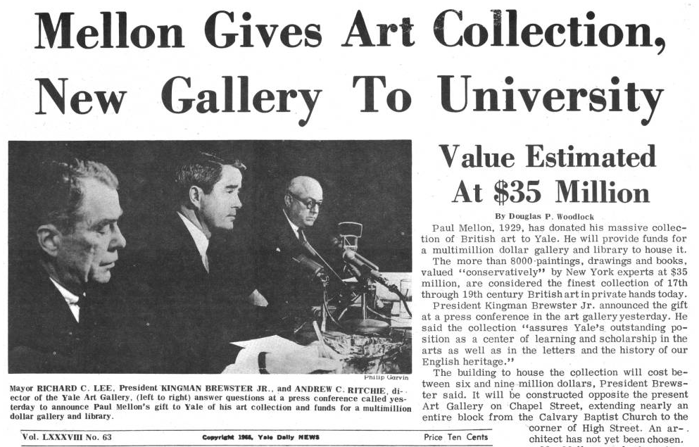
Paul Mellon Collection
1936: acquisition of George Stubbs’ Pumpkin with a Stable-lad
1959: meeting with Basil Taylor, Librarian at the Royal College of Art; acquisition of George Stubb’s Zebra
1963-65: Painting in England, 1700-1850, Collection of Mr. & Mrs. Paul Mellon at the VMFA & RA, London
1966: announces his gift to Yale University
http://digital.library.yale.edu/cdm/compoundobject/collection/yale-ydn/id/54226/rec/48
Notes:
1966: Yale announces Paul Mellon’s gift to the university, which included his still growing collection, the building to house it, and endowment funds for maintenance of the building, for academic, and for curatorial purposes.
After Paul Mellon announced the gift of his collection to Yale, John Baskett mentioned that he changed his collecting pattern, increasing its breath and depth to include traditional portraits, a bit more on the model of what his father had collected for the NGA. Wouldn’t it be nice to see this come through the data, and be able to see the network of dealers he relied on before and after the Yale announcement?

Slide 8
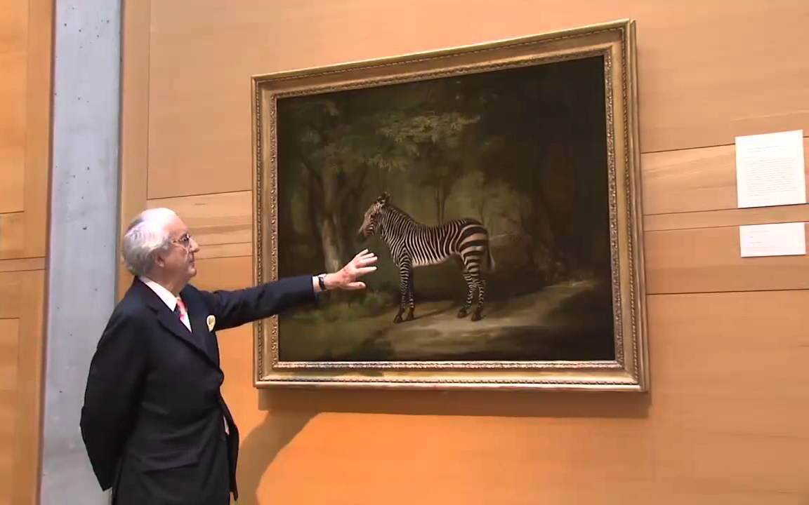
Paul Mellon Collection
1936: acquisition of George Stubbs’ Pumpkin with a Stable-lad
1959: meeting with Basil Taylor, Librarian at the Royal College of Art; acquisition of George Stubb’s Zebra
1963-65: Painting in England, 1700-1850, Collection of Mr. & Mrs. Paul Mellon at the VMFA & RA, London
1966: announces his gift to Yale University
1968: John Baskett comes in as advisor
John Baskett, Paul Mellon’s advisor (from 1968 on)
Notes:
1968: Basil Taylor resigned in his role of advisor and John Baskett comes in. He acted for Paul Mellon in the salerooms until 1990, when he retired from the Bond Street art dealership he had established with Richard Day in 1967. Baskett’s friend, Dudley Snelgrove, helped advise Paul Mellon as well, especially with drawings acquisitions.

Slide 9
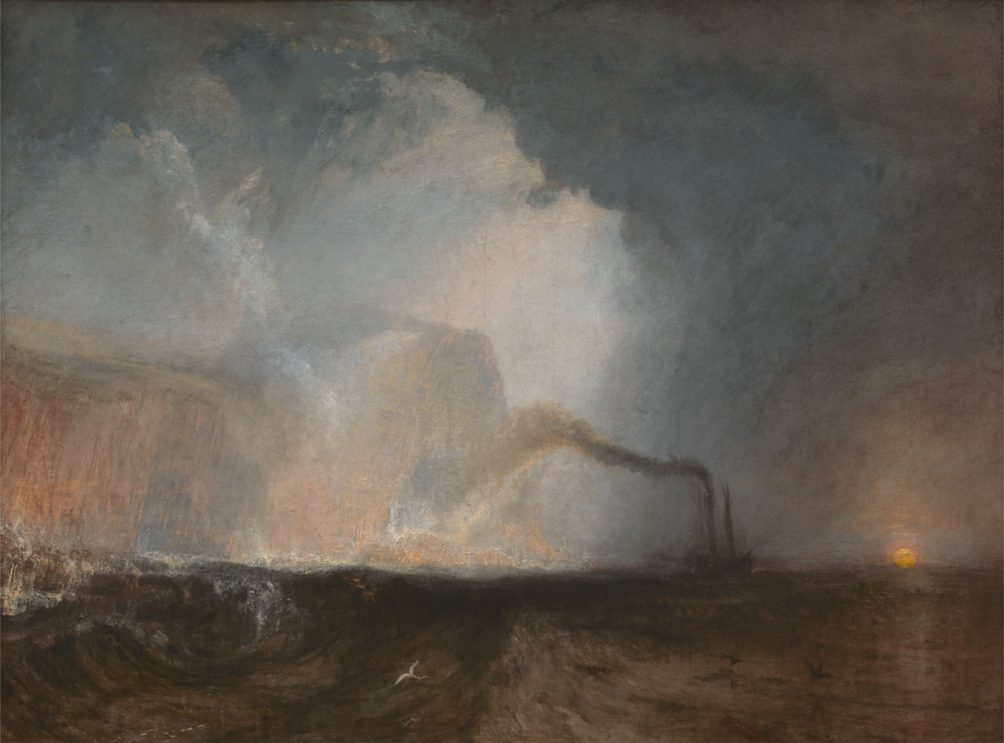
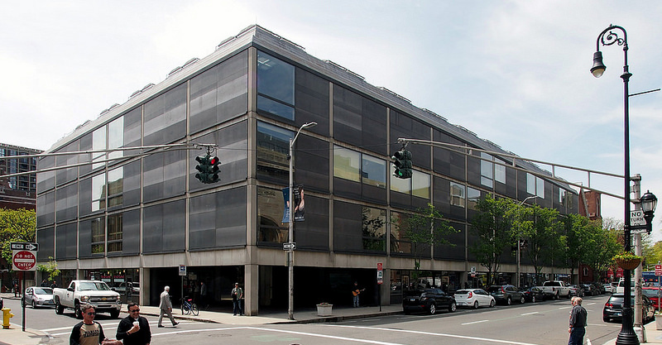
Paul Mellon Collection
1936: acquisition of George Stubbs’ Pumpkin with a Stable-lad
1959: meeting with Basil Taylor, Librarian at the Royal College of Art; acquisition of George Stubb’s Zebra
1963-65: Painting in England, 1700-1850, Collection of Mr. & Mrs. Paul Mellon at the VMFA & RA, London
1966: announces his gift to Yale University
1968: John Baskett becomes his advisor
1977: YCBA opens; PM buys Turner’s Staffa
Joseph Mallord William Turner, 1775–1851, British, Staffa, Fingal's Cave, 1831 to 1832, Oil on canvas, Yale Center for British Art, Paul Mellon Collection, B1978.43.14, http://collections.britishart.yale.edu/vufind/Record/1669251
Notes:
1977: YCBA opens. Paul Mellon provided the museum with endowment for collection development. Sometimes he funded major purchases recommended by the museum. He also continued to acquire for himself in consultation with the museum’s directors (Jules Prown, Edmund Pillsbury, Duncan Robinson). And I here it would be great to have access to the institutional archives to read their correspondence.
Paul Mellon buys Staffa in 1978 from Thos. Gibson Fine Art Ltd. as its second American owner since the painting was acquired by C.R. Leslie directly from the artist in 1845. How many American collectors were buying British art by then?

Slide 10
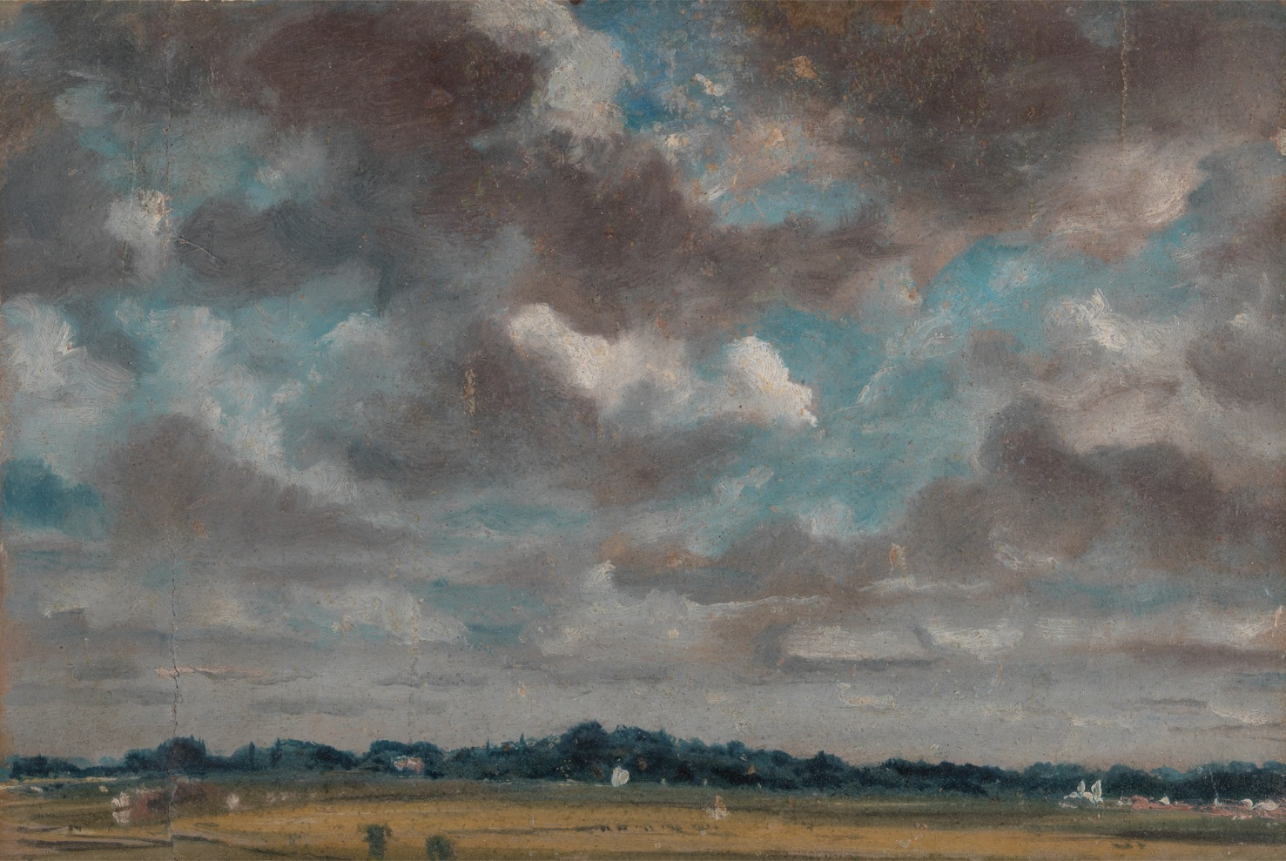
Paul Mellon Collection
1936: acquisition of George Stubbs’ Pumpkin with a Stable-lad
1959: meeting with Basil Taylor, Librarian at the Royal College of Art; acquisition of George Stubb’s Zebra
1963-65: Painting in England, 1700-1850, Collection of Mr. & Mrs. Paul Mellon at the VMFA & RA, London
1966: announces his gift to Yale University
1968: John Baskett becomes his advisor
1977: YCBA opens; PM buys Turner’s Staffa
1981: second bequest to YCBA (730 paintings)
John Constable, 1776–1837, British, Extensive Landscape with Grey Clouds, ca. 1821, Oil on paper on panel, Yale Center for British Art, Paul Mellon Collection, B1981.25.3, http://collections.britishart.yale.edu/vufind/Record/1669409
Notes:
1981: second bequest from Paul Mellon, which includes this Constable Cloud Study, bought from Christie's by John Baskett, London in 1961 for Paul Mellon. John Baskett did not always have the same role. Sometimes he was an advisor, but at other times he would act in place of Paul Mellon through his own gallery.

Slide 11
Paul Mellon Collection
1936: acquisition of George Stubbs’ Pumpkin with a Stable-lad
1959: meeting with Basil Taylor, Librarian at the Royal College of Art; acquisition of George Stubb’s Zebra
1963-65: Painting in England, 1700-1850, Collection of Mr. & Mrs. Paul Mellon at the VMFA & RA, London
1966: announces his gift to Yale University
1968: John Baskett becomes his advisor
1977: YCBA opens; PM buys Turner’s Staffa
1981: second bequest to YCBA
1990: last purchase: Roubiliac’s bust of Alexander Pope through John Baskett in memory of Basil Taylor
Paul Mellon (1907-1999) and Thomas Dawson, first Baron Dartrey (Later first Viscount Cremorne). Bust by Joseph Wilton RA, 1722–1803, British, ca. 1770, Carrara marble on an original oval socle, Yale Center for British Art, Paul Mellon Collection, B1977.14.33, http://collections.britishart.yale.edu/vufind/Record/1666381
Notes:
1990: last purchase that Paul Mellon made on his own account, but which he promptly gave to the museum: bust by Roubiliac of the poet Alexander Pope in memory of Basil Taylor

Slide 12
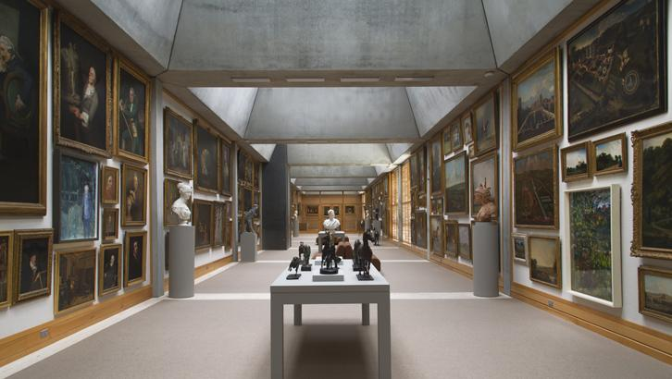
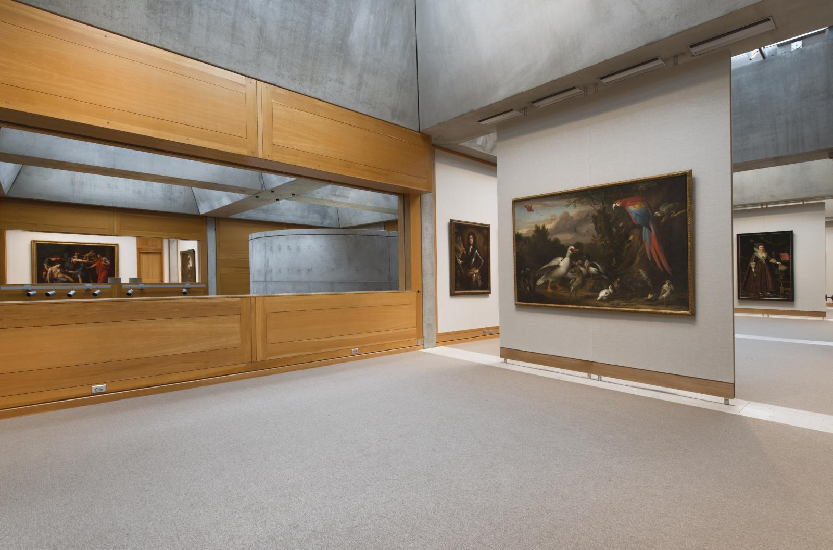
Paul Mellon Collection
1936: acquisition of George Stubbs’ Pumpkin with a Stable-lad
1959: meeting with Basil Taylor, Librarian at the Royal College of Art; acquisition of George Stubb’s Zebra
1963-65: Painting in England, 1700-1850, Collection of Mr. & Mrs. Paul Mellon at the VMFA & RA, London
1966: announces his gift to Yale University
1968: John Baskett becomes his advisor
1977: YCBA opens; PM buys Turner’s Staffa
1981: second bequest to YCBA
1990: last purchase
1999: distribution of works from the Brick House
Notes:
1999: distribution of works from the Brick House after Paul Mellon’s death. And here I am showing the most recent hanging of the permanent collection in the study gallery (top) and 4th floor gallery. This new 2016 reinstallation of the permanent collection is the one which shows the most works on display from any of the previous 4 installations.

Slide 13
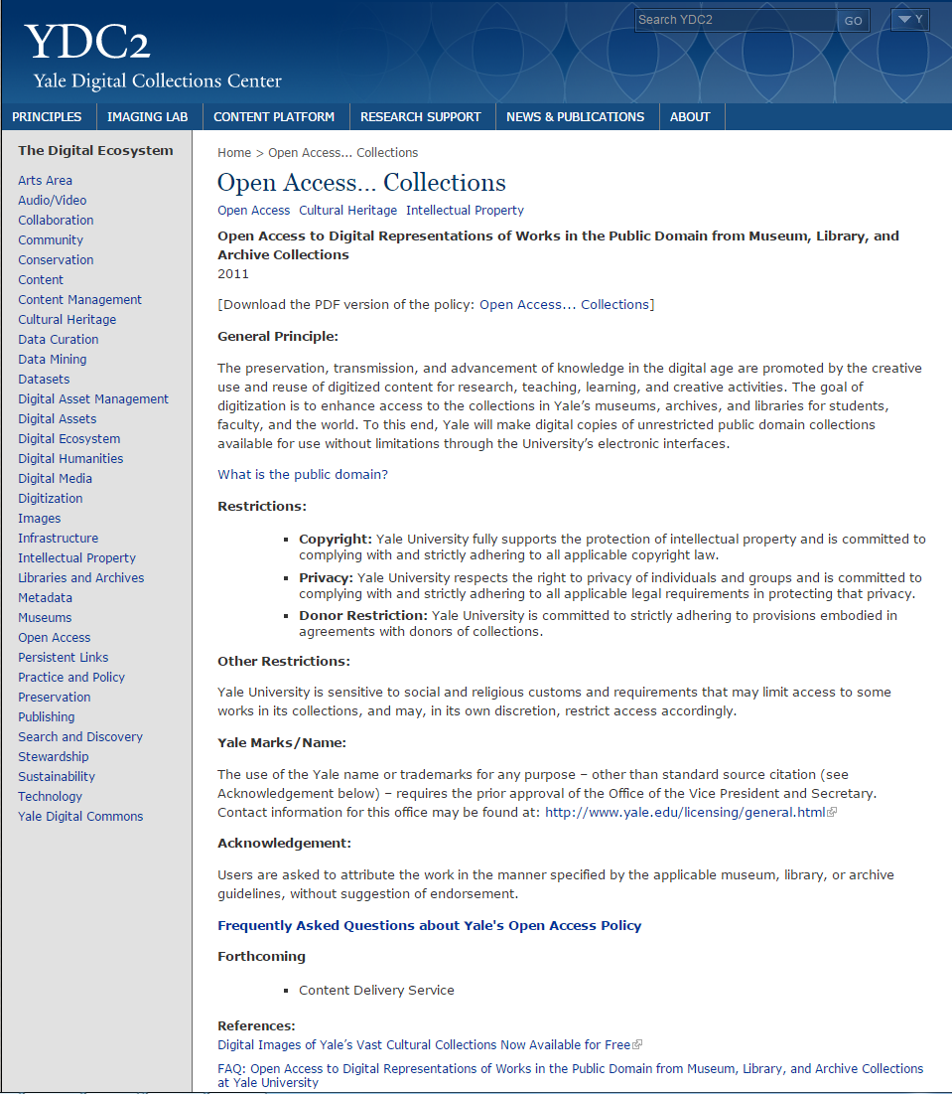
YCBA’s Implementation of the Yale Open Access Policy for works in the public domain
No authorization required
No fees due to the YCBA/Yale
Commercial purposes allowed
http://ydc2.yale.edu/open-access-collections
Notes:
Paul Mellon was clear in his intention for the museum to be a place where to enjoy British Art and a resource to support the study of British life and culture. The museum was free from the day it opened. Today we are striving to carry on our founder’s generosity by our implementation of the Yale University Open Access policy. Since 2011, under the policy, anyone may use the Center’s open access material without further application, authorization, or fees due to the Center or to Yale, that includes commercial purposes and high resolution images of works in the public domain. (The Yale policy specifically addresses works in the public domain, and doesn’t address works under copyright.)

Slide 14
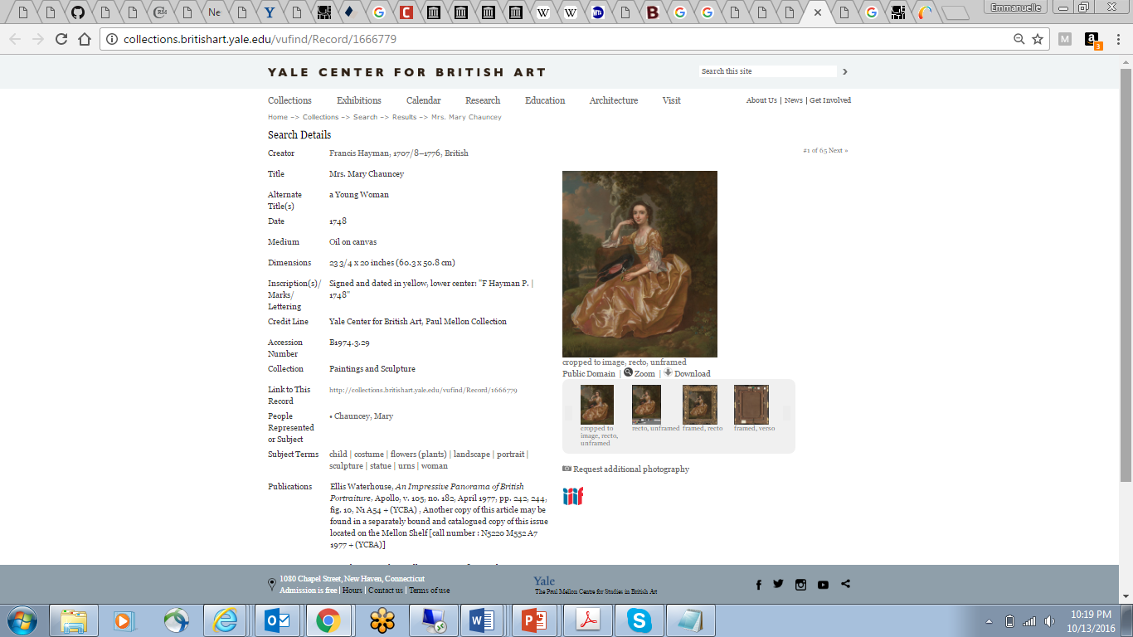
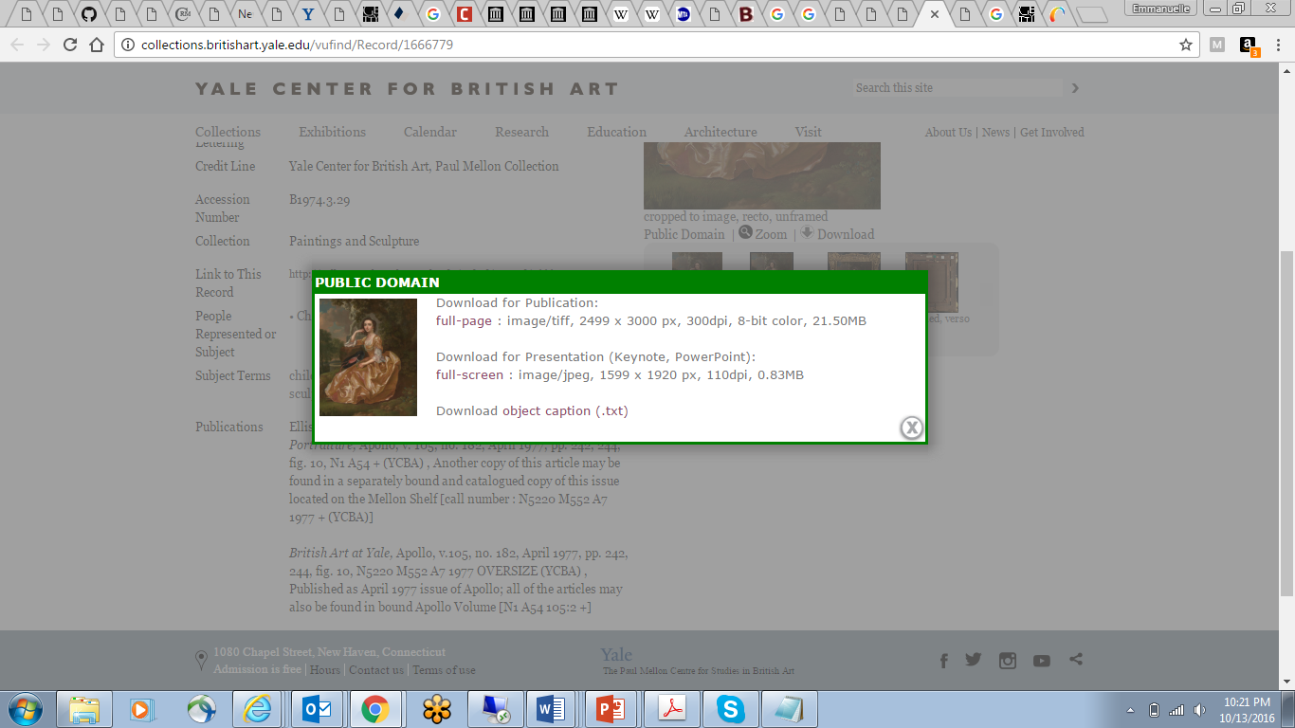
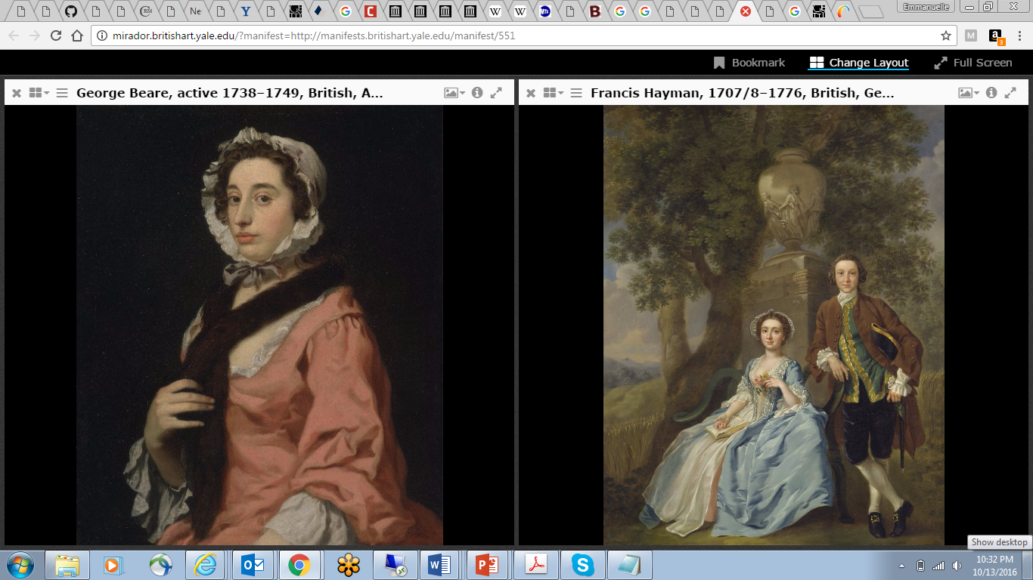
Image access through free download and IIIF
Notes:
The YCBA implemented this policy with a great degree of openness, again it includes free reuse of high resolution images of works in the public domain, with no commercial or credit restrictions on usage whatsoever. Many museums have join the movement since, but it was quite groundbreaking in 2011. And here I am showing an example of an object record from our online collections catalog with the download functionality. I am also showing our images through the Mirador image viewer (lower right) that we just launched last month that allows to manipulate images when they are IIIF compliant, either from the YCBA and/or from other IIIF compliant institutions.

Slide 15
Yale Center for British Art’s Digital Strategy
Use technology to make
collections images and data as accessible as possible
for creative and scholarly resuse
Open Access policy
International Image Interoperability Framework
Linked Open Data (CIDOC CRM ontology)
Notes:
So how is this relevant today?
Well, the museum is dedicated to using technology, such as IIIF and LOD, to make its collection images and data as accessible as possible for anyone to reuse for any purpose, and that includes sharing our collections’ provenance in a way that makes it understandable and easy to reuse. And from the set of questions I asked while going over the history of the Paul Mellon collection you can tell that the bar is fairly high. Those are not traditional questions about the simple descriptions of the physical objects. These questions invoke networks of people and series of events that our current databases cannot answer.

Slide 16
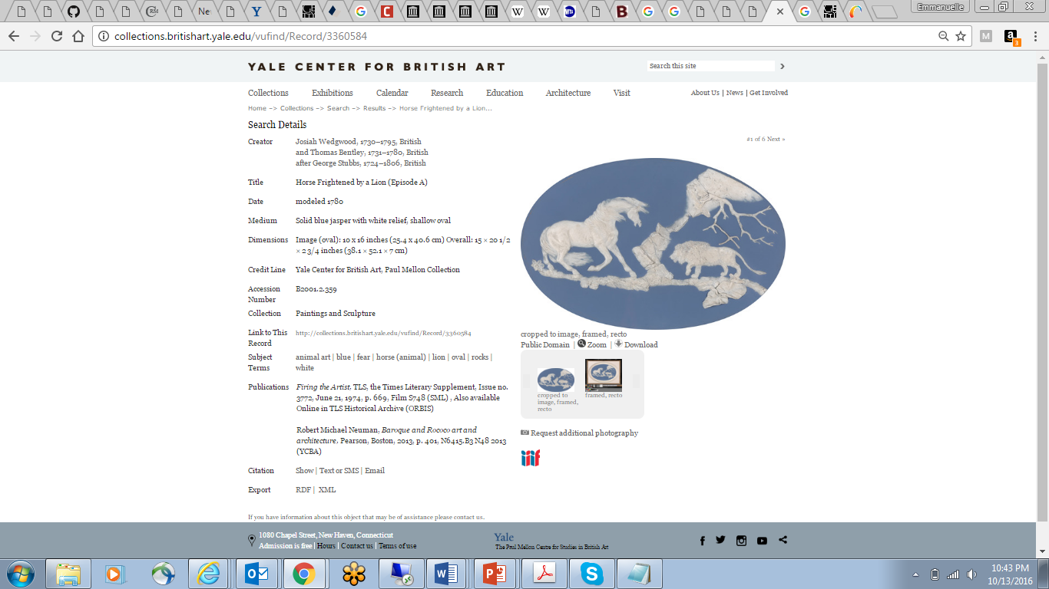

Access through machine readable format
Linked Open Data semantic endpoint
CIDOC-CRM (Conceptual Reference Model)
Notes:
And I think at this point it is useful to mention that the museum has been working with Linked Open Data since 2013 and here I am showing our linked open data semantic endpoint (lower right) and the RDF export functionality in each record. But we are still learning a lot about Linked Open Data and this was a massive interest for collaborating with CMOA.
The Center’s machine readable data can also be accessed querying our Linked Open Data semantic endpoint. As many other cultural heritage institutions, the Center has been digitizing its collections for quite some time (cataloguing and imaging) but unlike many others, at least in the United States, it has taken the additional step to organize its data with an ontology called the CIDOC-Conceptual Reference Model. The CRM has been developed over many years, and is still developed by a community of active cultural heritage institutions practitioners, and is supported by the International Council of Museums’ Committee of Documentation (ICOM CIDOC).
As a side note here I would like to say that we use LIDO as a transport mechanism but the CRM represents the knowledge that the Center outputs much better and we will see why in a minute.

Slide 17
Provenance: Current challenges
Need more support from CMS beyond free text fields for structured data
Reliance on grammar/conventions not widely known by non-expert
Conventions are not standardized across museums
No integrated analysis possible because data is siloed
Notes:
So what is the state of affairs with provenance?
Provenance has traditionally been formatted with protocols that are difficult to decipher by non-experts. Provenance is critical to museum and library documentation and yet managing this information as data has always been problematic for collecting institutions. Remarkably, neither the advent of computerized databases, nor the recognition that museums have a responsibility to determine their legal title to works of art, have made this task any easier; most of the standard collection management systems offer little or no support for provenance data beyond fields for recording free text entries.
Another challenge is that most museums have developed their own local grammar to record provenance, making it difficult for non-experts to decipher and difficult to harmonize with the conventions of other museums.
Despite the recently published the American Association of Museums Guide to Provenance Research by Nancy Yeide (Washington DC, 2001) the museum community has not, to date, agreed to a common standard.
And museums’ databases are isolated from one another making it impossible to pose complex queries to provenance documentation. For instance, while it is possible to identify all the objects owned by an individual within a single collection database, it is not possible to see all works owned by that individual subsequently given to another specific individual even within one collection let along across multiple collections.

Slide 18
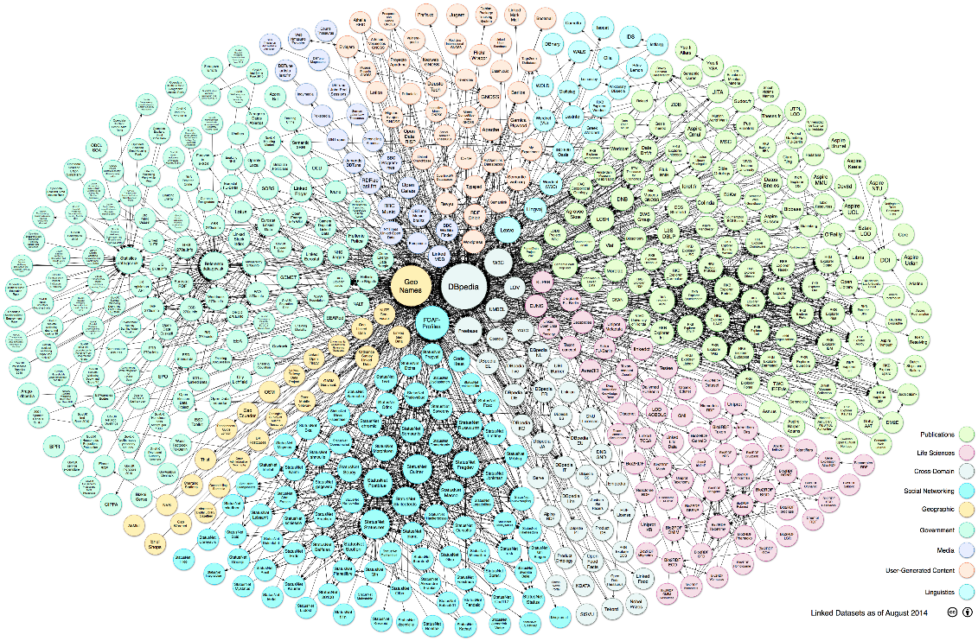
What is Linked Open Data?
LOD is a method of publishing structured data using standard Web technologies (HTTP, RDF, and URIs) so that it can be interconnected with other data and become more useful
Notes:
So what is Linked Open Data and how can Linked Open Data be helpful?
Linked Open Data is a method of publishing structured data online so that it can be connected with other museums’ data and become more useful.
Structured data is the information that is the database fields of our collections management systems. Linked Open Data uses the Web as a network to transmit the data and that’s great because that network reaches billions of users every day across the world. It’s great also because the Web is a place that our users are familiar with: that’s where they already go to consult our online collections catalogs. The difference from how we currently use the Web today is that LOD data brings disparate datasets together without the users having to redo their searches several times in separate websites.

Slide 19
What is Linked Open Data?
LOD focuses on data, not database systems
LOD is not a data project but good knowledge management
LOD is the most efficient way to manage intellectual assets in the digital realm
Notes:
A few crucial points about LOD:
LOD focuses on data, not database systems
And this is critical. With LOD we are working with data that is extracted out of our databases’ content and ported to the Web. This is great because that means we don’t have to worry about databases talking to each other anymore. With our data freed from their silos we can concentrate on what makes cultural heritage institutions’ data so unique, which is its richness. LOD is not a portal, or an aggregation. It is a data format that links disparate datasets together.
LOD is not a data project but good knowledge management. This is also another critical point: LOD is not a format for a specific one-off data project. Rather it is a best practice tool that can support the entire institution’s data strategic plan
LOD is the most efficient way to manage intellectual assets in the digital realm
LOD is perfectly well suited to expose the richness of museums’ data to the Web, unlike what most aggregators do right now because they require museums to map content to their internal metadata schema/target.

Slide 20
Why Linked Open Data?
Relevance of cultural heritage institutions in Semantic Web
Produce high quality knowledge for the future
“Something very important is happening that could revolutionise the way cultural and art organisations collaborate. This thing isn’t about massive aggregations and industrial scale portals. Rather it is about a change in culture and direction for individual organisations that want to directly engage with the Internet as a tool for sharing and developing our understanding and knowledge of the world.”
- Dominic Oldman,
British Museum Senior Curator and
Head of ResearchSpace
Notes:
So why do we need LOD? Well it is clear that the current technology that we are using to share our digital assets and data is both limiting user engagement and hindering research in a serious way. Think of Google’s gazillions of results but they do not understand context. This is a problem because researchers depend on the quality of digital resources for the progress of scholarship. So what is at stake here is nothing else than the usefulness of knowledge in the network.
Museums should take advantage of the Web’s ability to bring knowledge together. It is clear that it is a real request from users. They want more data, they want richer data, and they want to discover the connections that traverse our datasets easily. Being part of this connected digital corpus has a direct impact on the relevance of our institutions. Museums that do not participate in this wider engagement will find themselves increasingly isolated.
Dominic Oldman, British Museum senior curator and head of ResearchSpace, calls this shift of perspective nothing short of a revolution.

Slide 21
How to Linked Open Data?
We now have great tools to take advantage of this opportunity:
- Web technologies: automated machine protocols to transport data (http, URIs, RDF)
- CIDOC-CRM: semantic framework/data model/ontology designed to accurately represent the richness and specificity of cultural heritage institutions’ knowledge on the Web and enable semantic interoperability between multiple datasets
Notes:
How to LOD?
Luckily we now have great tools to take advantage of this opportunity. We have Web technologies: automated machine protocols to transport data.
And we have the CIDOC-CRM: semantic framework/data model/ontology designed to accurately represent the richness and specificity of cultural heritage institutions’ knowledge on the Web

Slide 22
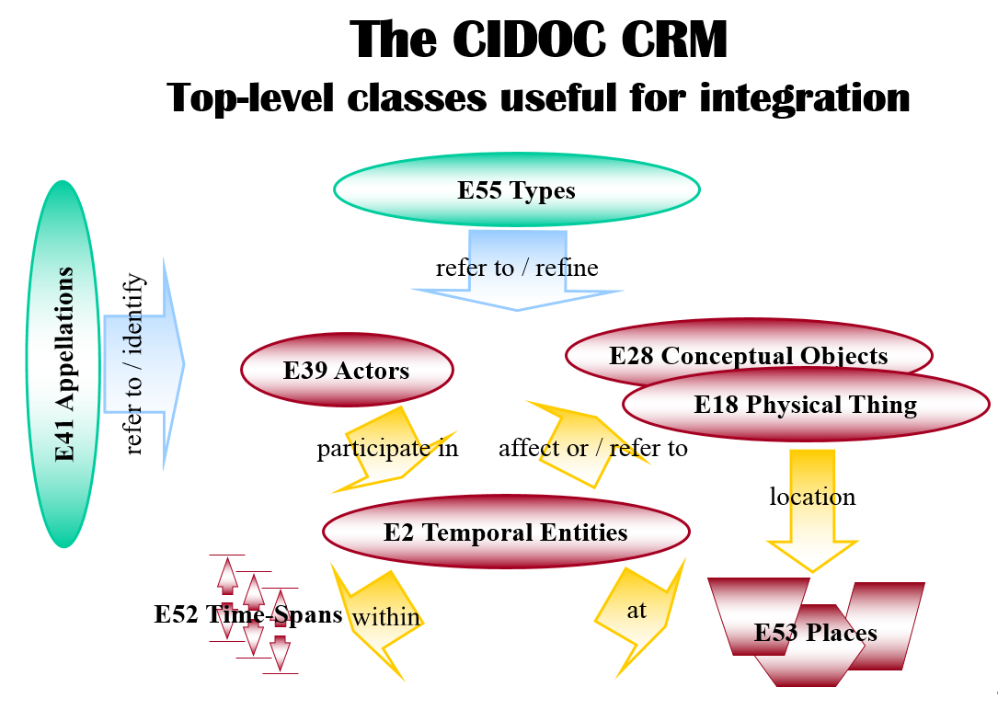
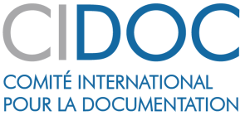
What is CIDOC-CRM?
The CIDOC-CRM makes relationships that are hidden in our databases’ data structure explicit for all to understand and build upon
The role of the Conceptual Reference Model ontology is to harmonize the semantic relationships created between things, people, places, events, times, and concepts from multiple datasets.
Notes:
The methodology for publishing information directly affects its usefulness within a digital forum. LOD is just an arena into which we publish cultural heritage information. CRM is the best language to express the complexity of the cultural heritage information, especially where semantic interoperability is necessary. The CIDOC-CRM is about making relationships that are hidden in our databases’ data structure explicit for all to understand and build upon. The CIDOC-CRM allows us to curate the raw data from our databases by putting it into context. It allows us to expand on the raw data that comes from our collections management systems, which by the way was not designed to be public facing.
“The CRM is a standard which will help you integrate cultural information from a variety of sources and bring them together into an integrated environment where you can ask bigger questions than you can ask from the individual pieces that you have.” – Stephen Stead.

Slide 23
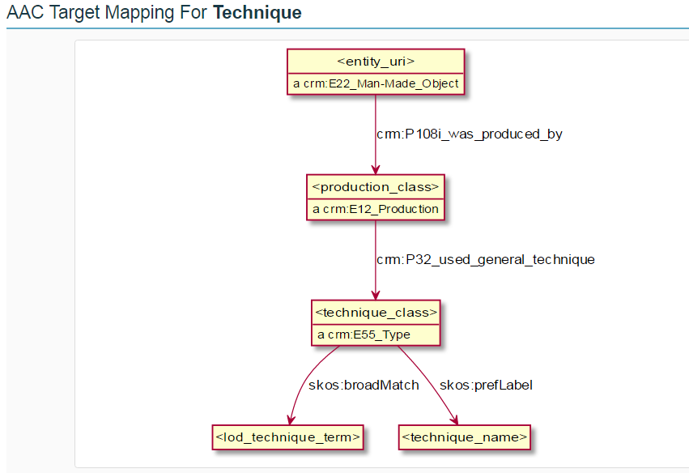
Data as network of knowledge
David Newbury’s tool for the American Art Collaborative consortium to review their data mappings to the CIDOC CRM
Notes:
A better way to look at CRM data is through graph. All of a sudden the notion of network of knowledge takes shape in front of our eyes.
So let’s look at the structure of a LOD graph. LOD relies on a data format that can be processed by machines. That format is called Resource Description Framework or RDF. RDF itself provides a way of describing information in a format known as a triple statement. As the name indicates, a triple is composed of 3 elements: subject, predicate, object. In addition to using triples to express, RDF uses Uniform Resource Identifiers or URIs to refer to real world thing on the Web and that’s a first big change from how we traditionally understand data. The second change here is that URIs refer to data, and not documents anymore. As Tim Berners-lee said, and I am paraphrasing, we can read documents but data is much more powerful because we can massage it and repurpose it. The third big thing to get used to when working with LOD is that LOD is best viewed as a graph. RDF structures data as a graph or network of connected statements, rather than a series of tables (as in a relational database). In a RDF graph or network resources, or nodes, are connected together by edges that describe the relationships between each resource.
(This graph and the one on slide 26 courtesy of David Newbury, Carnegie Museum of Art developer)

Slide 24
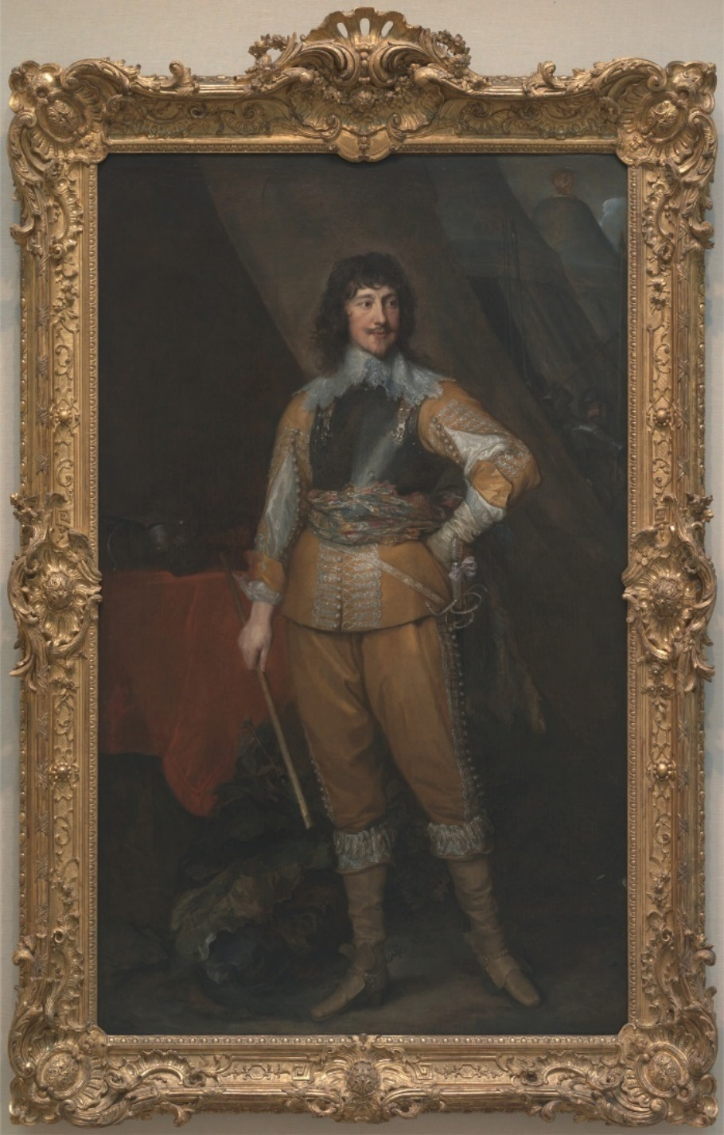
Provenance for Mountjoy Blount, Earl of Newport
by Sir Anthony Van Dyck, 1599–1641, Flemish, active in Britain (1620–21; 1632–34; 1635–41), 1637 to 1638, oil on canvas, Yale Center for British Art, Paul Mellon Collection:
Earls of Newport by descent to 4th Earl, who died in 1679, when title became extinct: bought (?) by 1st Earl of Bradford, by descent to 4th Earl, who died 1762, when title became extinct; Diana, Dowager Countess of Mountrath (d.1766), sister of the 4th Earl of Bradford, by inheritance; by descent to Lady Caroline Damer, ( d. 1829), and Henry Dawson-Damer (d. 1841); 3rd Earl of Portarlington, by inheritance; the Earl of Northbrook, acquired by exchange in 1881; Mrs. Anna Thomson Dodge, sale, Christie’s , 25 June 1971 (lot 10, from Duveen), bought John Baskett for Paul Mellon.
http://collections.britishart.yale.edu/vufind/Record/1669234
Notes:
This is a classic example of how the data that we publish online from our collections management databases are skipping over information. This is a fairly detailed provenance record for the YCBA’s only Northbrook collection object, but it is still missing crucial information, such as the identities and life dates of the 4 earls of Newport. If they are not identified as individual persons in the provenance text, they cannot be invoked in the LOD expression of this knowledge.

Slide 25
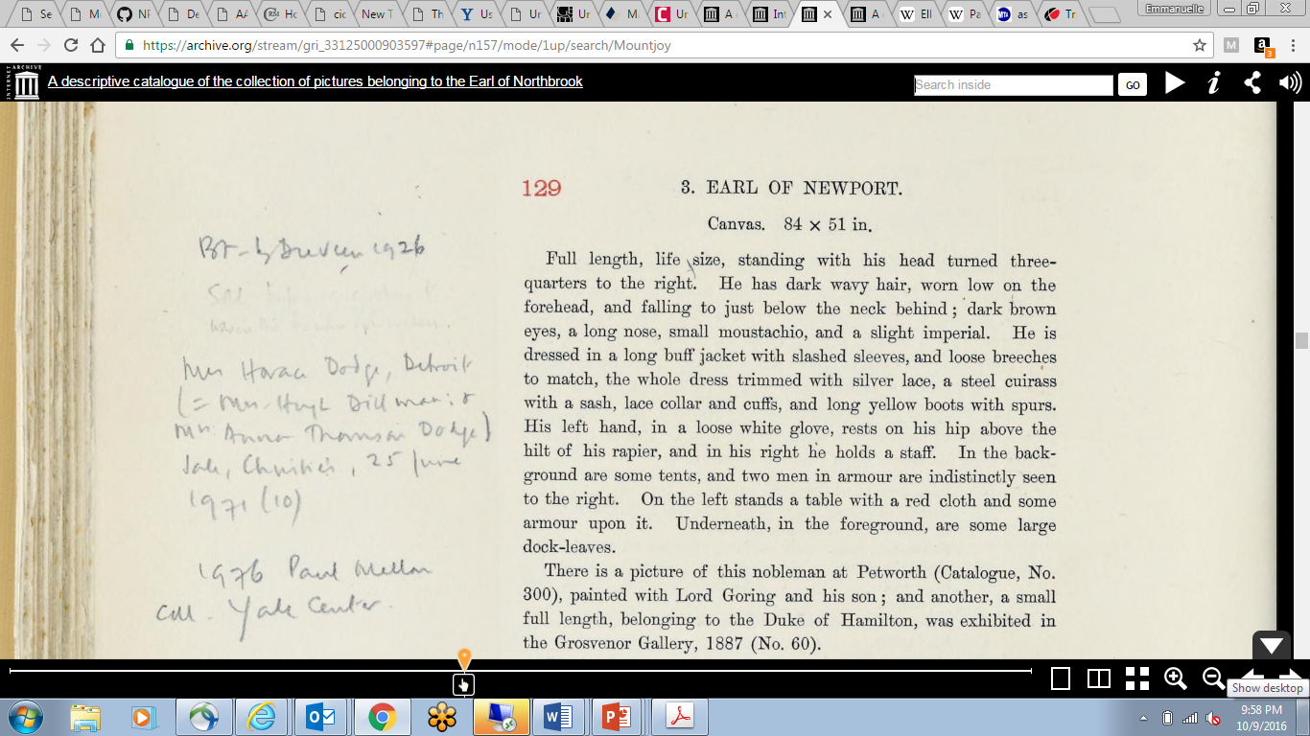
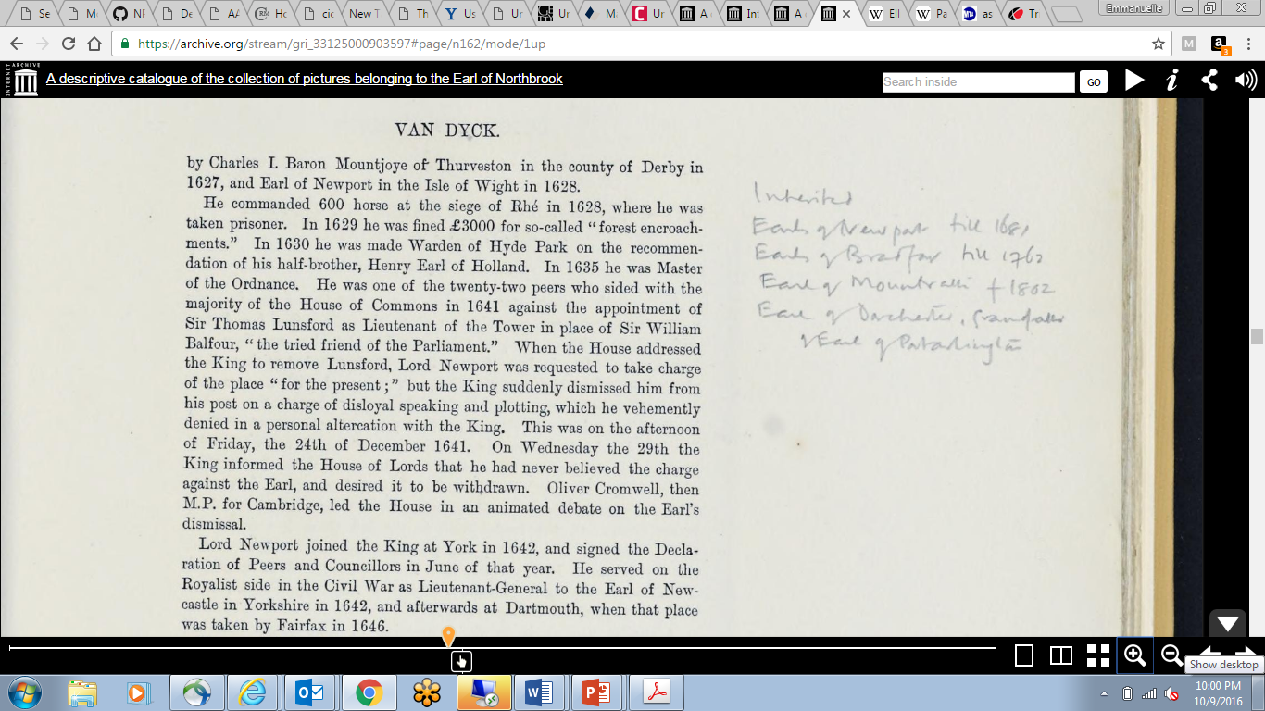
https://archive.org/stream/gri_33125000903597#page/n162/mode/1up
Carnegie Museum of Art 2016 Digital Provenance Symposium @edgartdata
Notes:
By contrast, this is Ellis Waterhouse’s annotated copy of the Northbrook collection catalog, which is available from the Internet Archives, a wonderful digital resource. It is a resource that we have yet to leverage for our research.

Slide 26
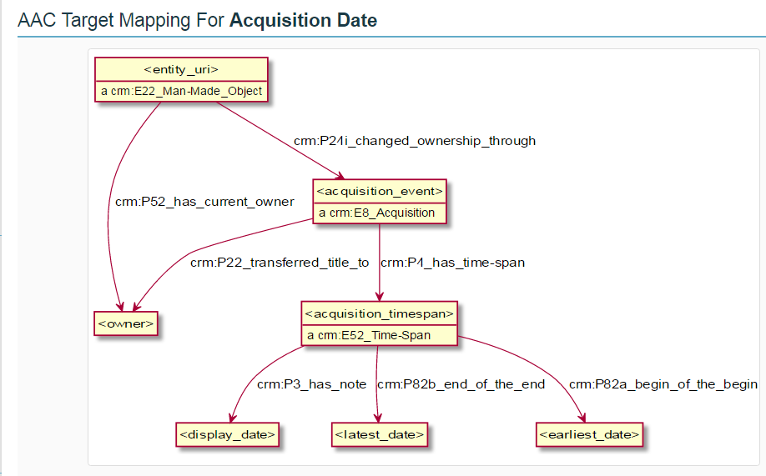
Data as network of knowledge
David Newbury’s tool for the American Art Collaborative consortium to review their data mappings to the CIDOC CRM
Notes:
Here is a CIDOC CRM expression of an acquisition transaction, with events clearly stated.

Slide 27
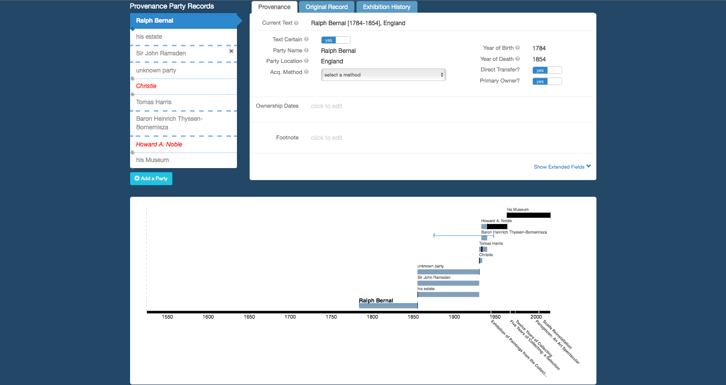
Tools to engage scholars: CMOA’s Elysa http://www.museumprovenance.org/
Notes:
Provenance information is complex and we need efficient tools to work with it. We also need to make sure that these tools are convenient to scholars since they will be working with them. An example of a good toolkit for scholars crafting knowledge for Linked Open Data is Elysa, which is has been developed by David Newbury, Carnegie Museum of Art’s developer, for the Art Tracks project. Elysa offers a clean and user friendly interface to standardize provenance entries, assign levels of uncertainty and visualize where there might be gaps in the data.
Tools like this one go a long way to engage scholars, which is crucial. We need scholars to take an active part in the representation of their knowledge in the semantic web.

Slide 28
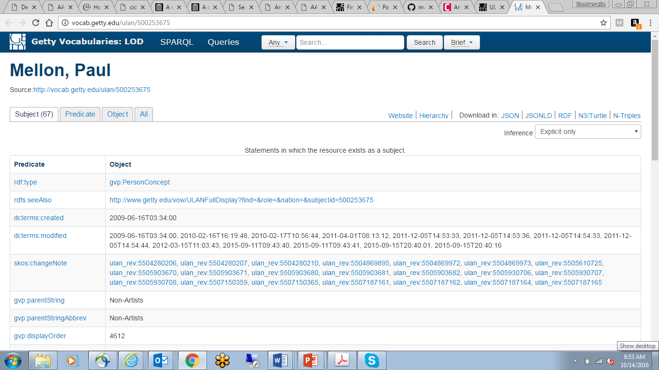
Notes:
Museums do not have to go at it alone: there are linked open data resources already available now, such as the Getty vocabularies. This means that museums can stick to what they do best, which is scholarship. They can then reference LOD resources such as the Getty’s.

Slide 29
Provenance: Linked Open Data opportunities
Relies on external authorities to document persons/organizations & events (citations)
Unambiguously documents the relationships between persons/organizations and transaction types/events
Supports integrated searching across multiple institutions
Uses the networked environment as a decentralized database
Supports semantic integration of multiple institutional datasets
Notes:
To conclude here are some opportunities offered by LOD:
Rely on external authorities to document people and organizations. Museums don’t have to do this alone. Link to libraries.
Relies on external authorities to document persons and organizations
Unambiguously documents the relationships between persons/organizations and transaction types/events
Supports integrated searching across multiple institutions
Uses the networked environment as a decentralized database
Supports semantic integration of multiple institutional datasets

Slide 30
Lessons learned
Same goal: tell a richer story about collecting art in the 20th century
Semantic interoperability is crucial
Usefulness of knowledge is at stake
Collaboration between scholars and technologists is crucial
Notes:
And to conclude I would like to emphasize 2 points: the usefulness of knowledge in the networked environment is at risk. We have the tools to fix it but it hinges on scholars and technologists working together and that’s why I am so amazed by CMOA’s leadership in particular, David, Lulu and Tracey.

Slide 31
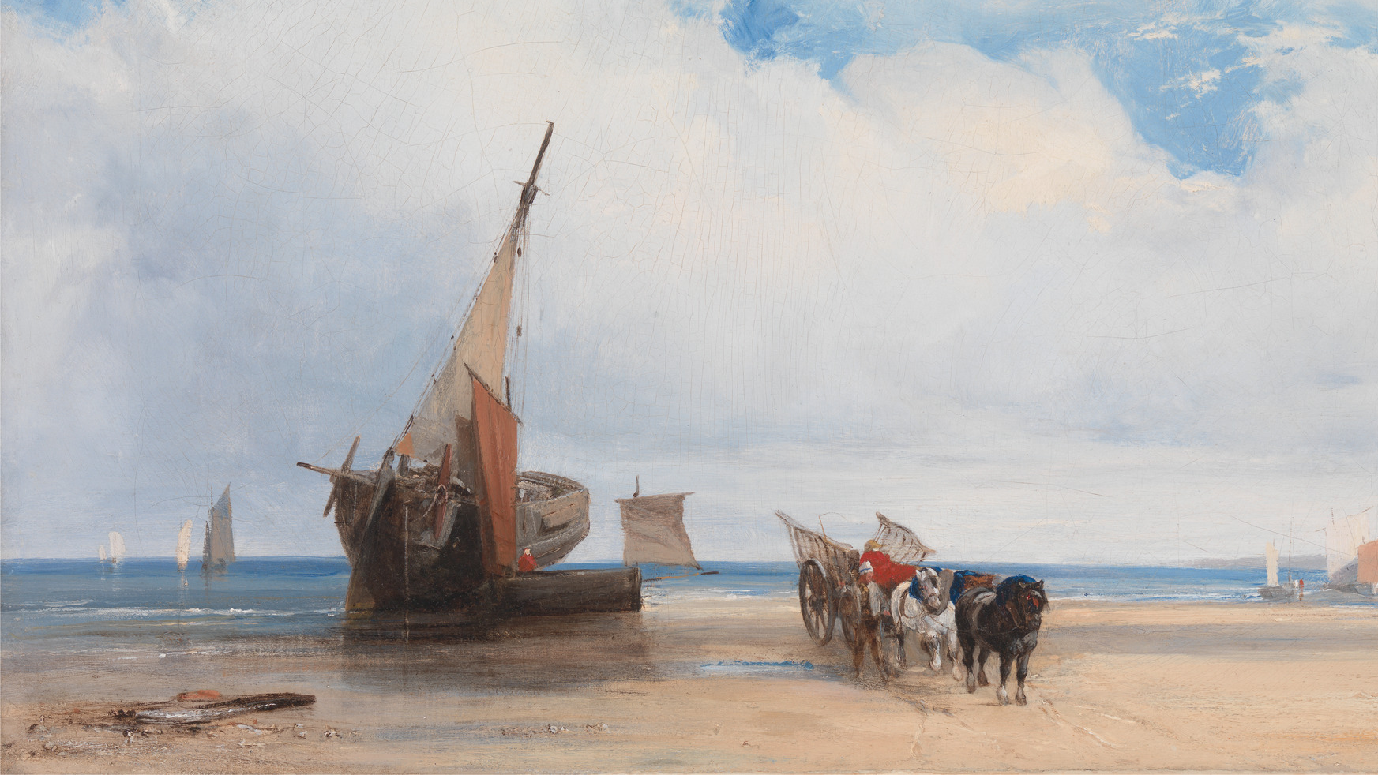
Thank you
http://www.cidoc-crm.org/
http://iiif.io/

